Slide 1
ECON 8320 Project
Noah Polacek

Slide 2
NIL Project
Goal: Collect and understand information of Name-Image-Likeness (NIL) deals.
Used the BeautifulSoup package to scrape a website for athlete information
https://nilcollegeathletes.com
Used Pandas to store and manipulate data
Used Plotly.express to create beautiful plots
Used sk.learn to fit a clustering model to the data
Background

Slide 3
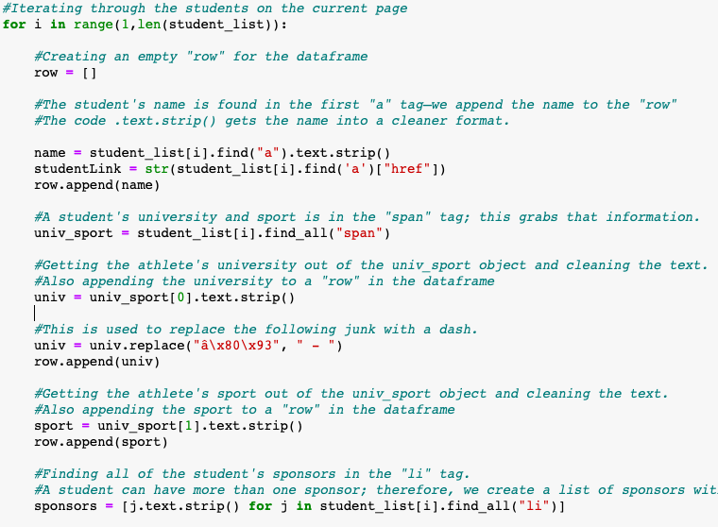
Web Scraper
Searched through all “tr” tags to get a list of students on the current page.
Gathered student’s name, university, sport, conference, and sponsors.

Slide 4
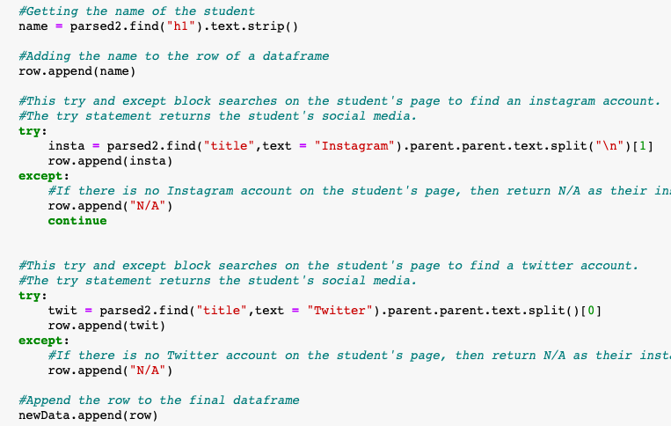
Web Scraper Continued
Crawled into each student’s subpage to get Instagram and Twitter accounts

Slide 5
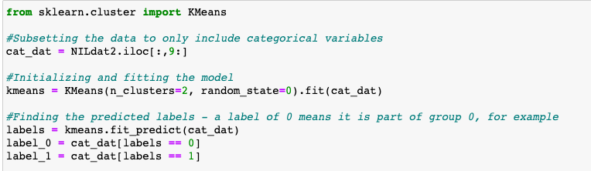
Fitting the Clustering Model
I tried to use a clustering model to find patterns in the data.

Slide 6
Difficulties
Finding how to effectively use BeautifulSoup to scrape NIL data.
HTML code is hard…
Getting the plotly package to show exactly what was desired.
Understanding how to use sk.learn to create a clustering model
The documentation was a lifesaver…
Did I mention the web scraper?

Slide 7
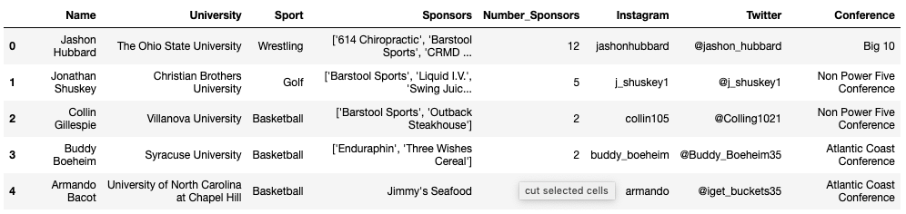
Results
Gathered the name, sport, university, sponsors, Instagram and Twitter accounts of 8,390 NIL-sponsored student athletes.
Did exploratory data analysis on the gathered data
Next slides have plots that explain findings.
First 5 rows of dataset

Slide 8
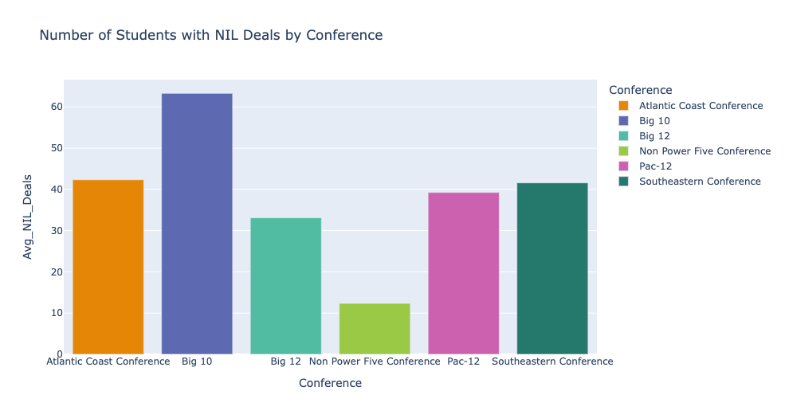
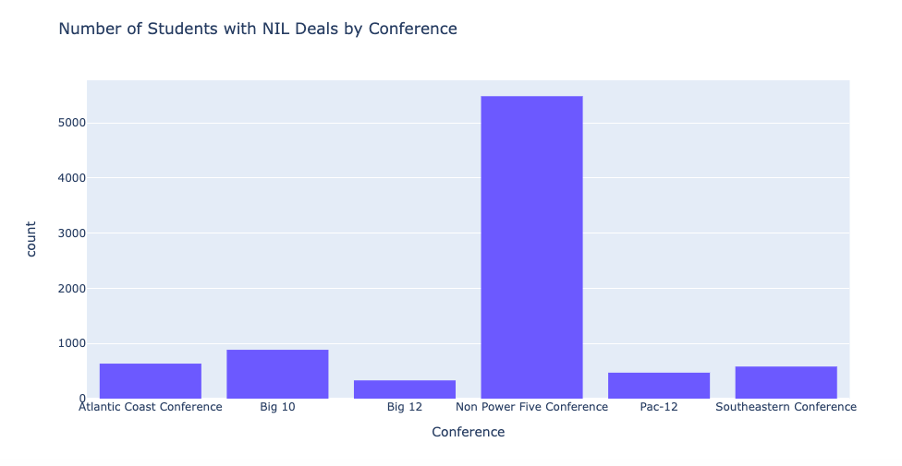
Non power five schools have majority of NIL deals, but the Big 10 has the most “per capita”

Slide 9
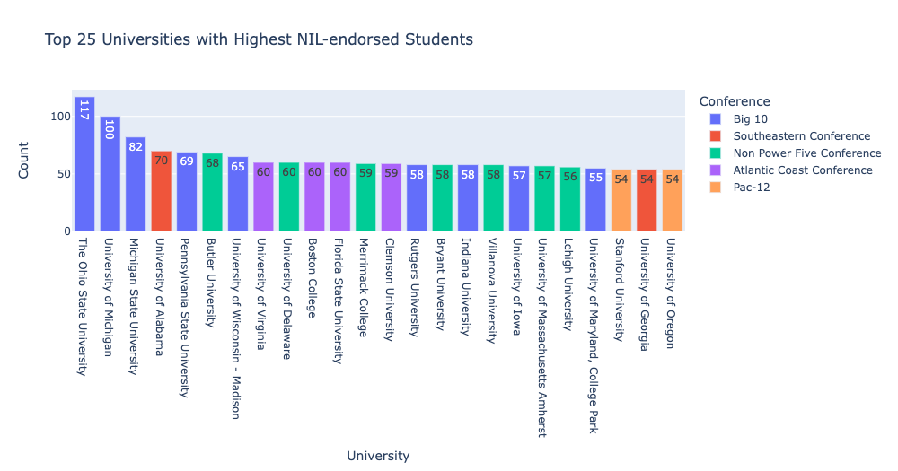
Big 10 best conference?

Slide 10
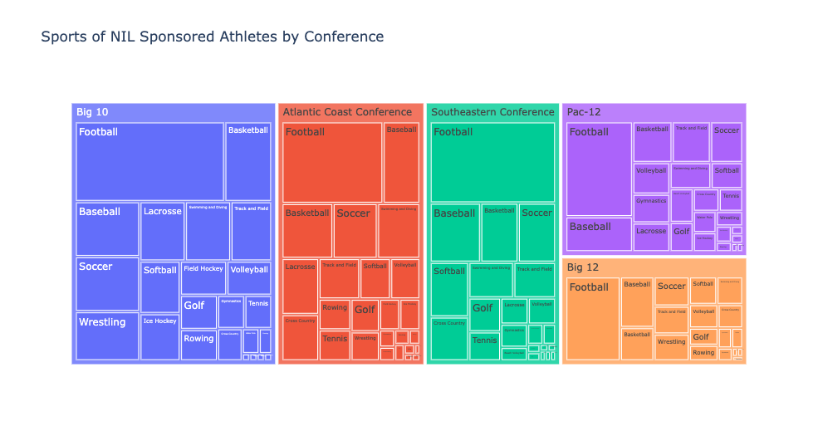

Slide 11
Model Findings
The model grouped students into two groups - one with Power FIve students and one without them.
NIL-endorsed students in the Power FIve conferences use Twitter and Instagram at a higher rate than non-Power Five students.
Twitter is more popular in both of the groups.

Slide 12
Questions?

